Slide 1
SPEED TYPING TEST
1602-20-737-044_SREENIJA
1602-20-737-045_SRIJA
1602-20-737-047_SRUTHI BHAVANA

Slide 2
ABSTRACT
Speed Typing Test application is useful to test/measure the typing speed of a user. Learn typing and find how fast you can type. Letters are highlighted to help you focus on typing.
You can become a typing master with the help of this app or can play typing games for fun. You need to add the language-specific keyboard to type in that language.
In this project, you will create a Typing Test, which will allow users to measure their typing speed.
Implementation of the user level is intended to secure the data from unauthorized third parties so that only users can see the results of learning.
Furthermore, the application also gives users the opportunity to participate in learning

Slide 3
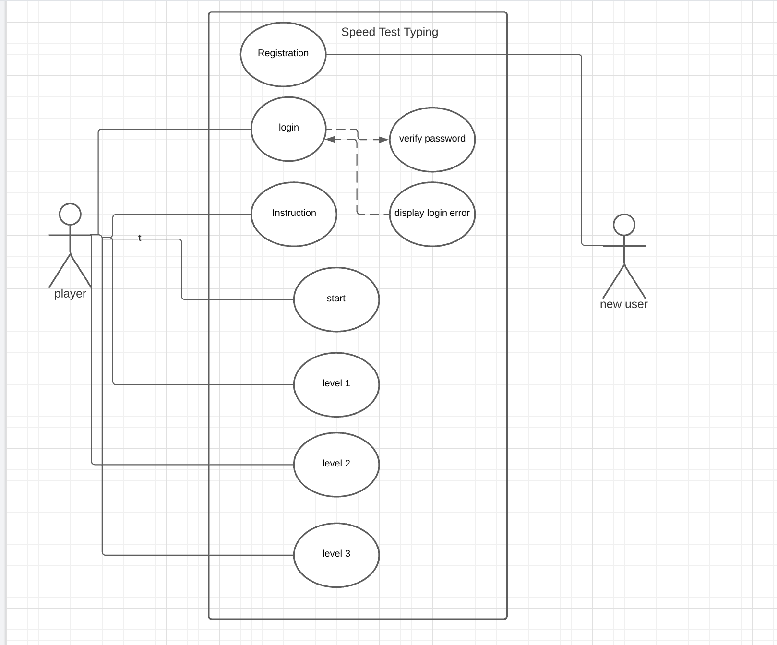
USE CASE DIAGRAM

Slide 4
TECHNOLOGY USED
Hardware Requirements
512 MB RAM
2GB HDD
CORE i5
Software Requirements
Windows XP/ Windows 2000
Python
Interpreter Packages used
Tkinter
Pygame
random

Slide 5
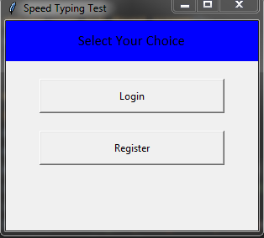
EXECUTION

Slide 6
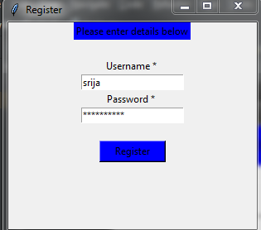
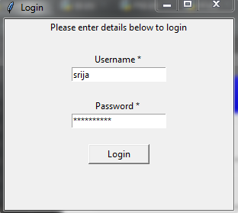
Registration and Login page:

Slide 7
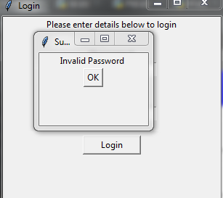
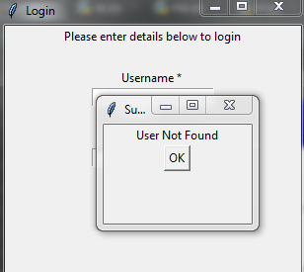
Login errors:
Invalid password error
User Not Found error

Slide 8
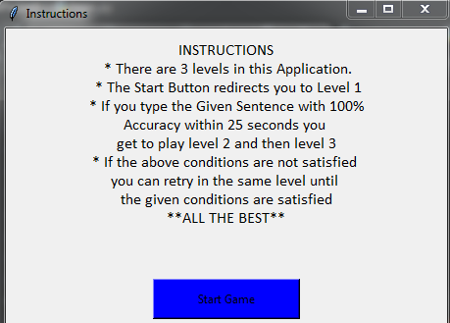
Instructions:

Slide 9
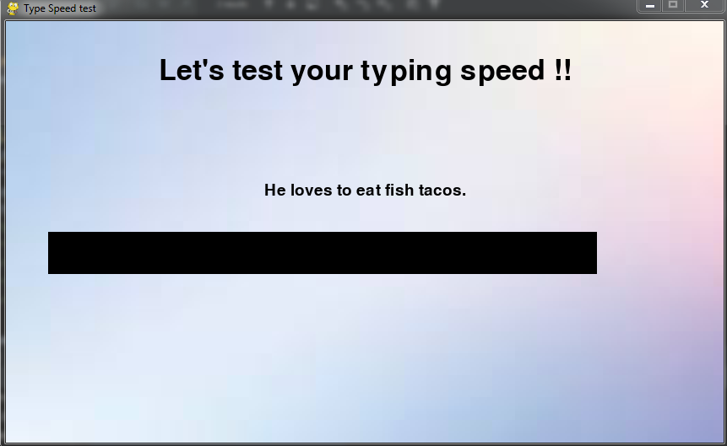
Level 1:

Slide 10
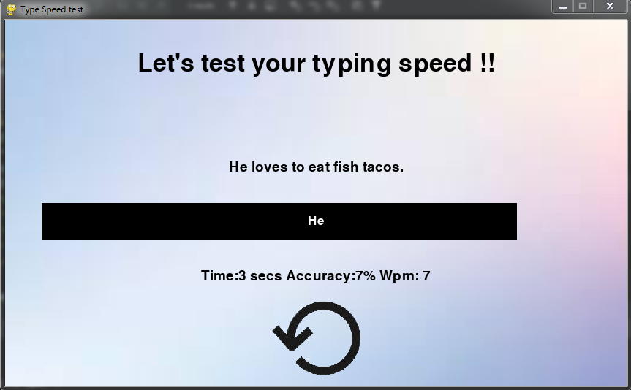
Level 1 Retry:

Slide 11
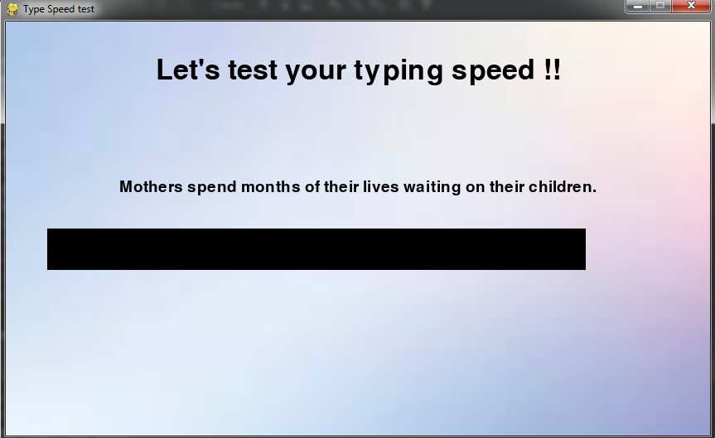
Next Levels:

Slide 12
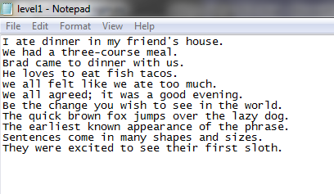
Sentences for level 1:

Slide 13
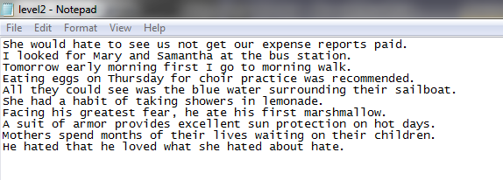
Sentences for level 2:

Slide 14
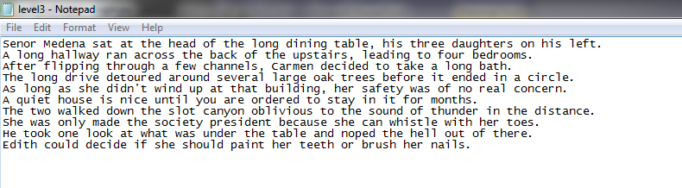
Sentences for level 3:

Slide 15
CONCLUSION
Speed typing test contains 3 levels.
The game starts with level1, if the user types the sentence with 100% accuracy within 25 sec then it automatically goes to next level and so on.
If it does not reach target same level will be repeated.
Moving to each level the size of the sentences will be increased.

Slide 16
FUTURE SCOPE
We would like to add more features to our project like calculating the high score and also display the previous performances and also a time limit is given to the user to type in the sentence.
We would like to add more levels to the game and the user can continue from which level they stopped.

Slide 17


